Slide 1
COMPANY X Customer & Credit Risk Analysis 2025
Presenter: Bui Diep Thanh Vy
Date: 16/10/2025

Slide 2

Contents
Overview
Customer Segment Analysis
Credit Quality Evaluation
Key Insights
Recommendations
Conclusion

Slide 3





Overview
Period: 5th Feb ~ 6th Aug 2025
Total loan amount: 11 billion VND
1,000 customers, with 107 overdue (10.7%)
NPL%: 7.1%, indicating moderate portfolio risk
Overdue Rate: 9.88%, Average DPD: 4.97 days
The loan book remains stable, but overdue customers and NPL levels show early warning signals.

Slide 4
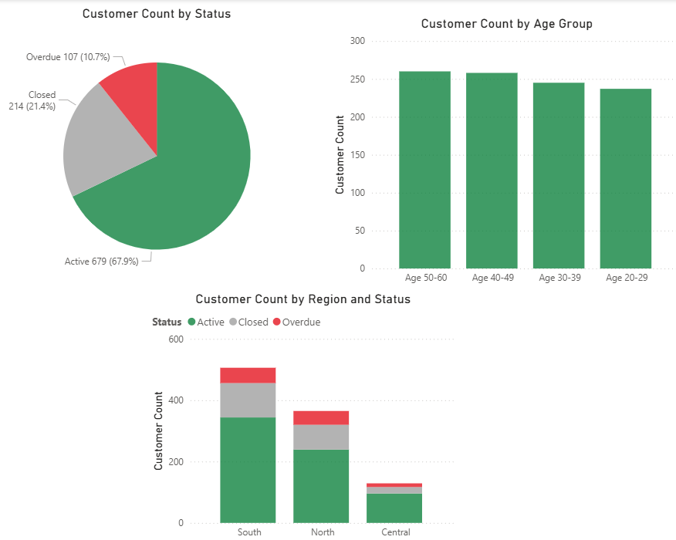
Customer Segment Analysis
Loan Status: 67.9% active, 21.4% closed, 10.7% overdue.
Age Group: Most customers aged 40–60.
Region: Southern region has the most borrowers and the highest overdue rate.

Slide 5
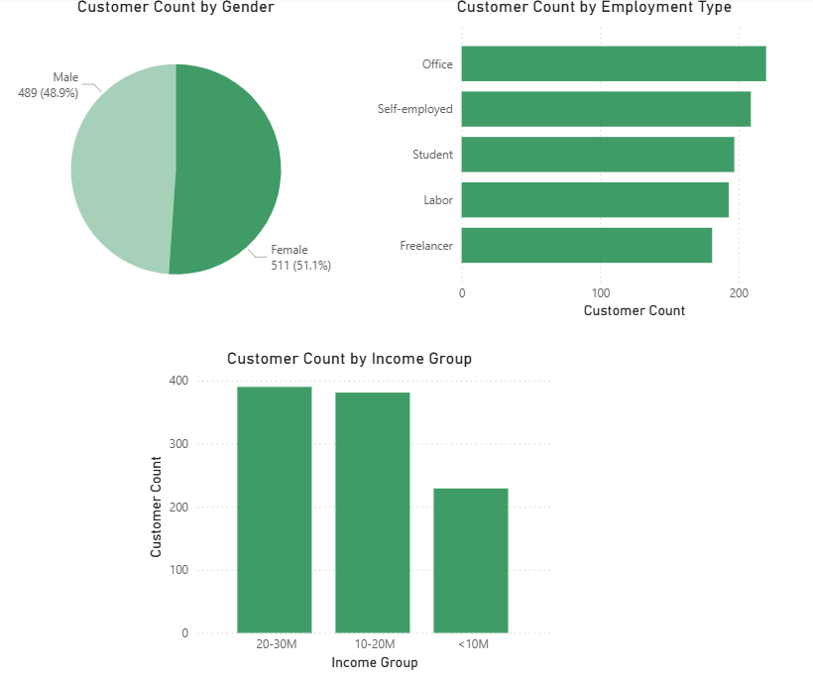
Customer Segment Analysis
Gender: Nearly balanced – 51.1% female, 48.9% male.
Employment Type: Mostly office workers and self-employed; students and laborers, freelacers follow.
Income Group: Majority earn 20–30M VND/month; lowest group earns under 10M VND.

Slide 6
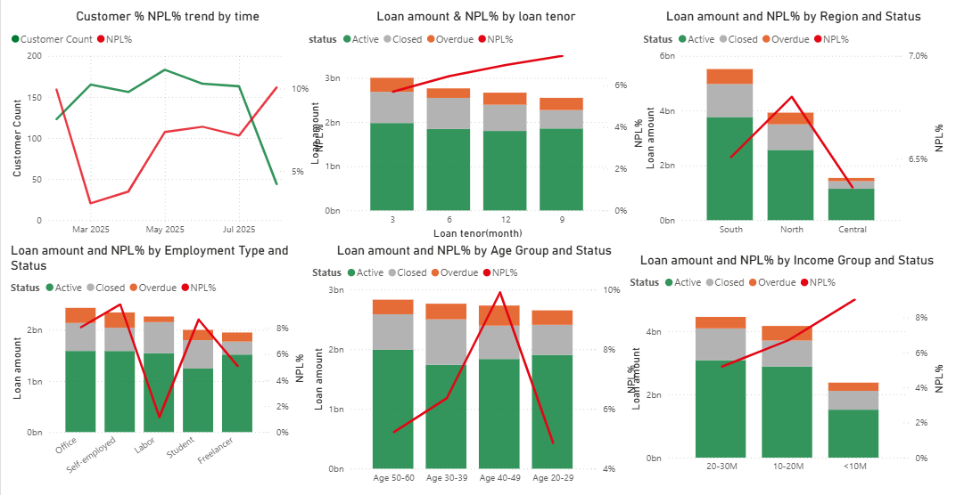
Credit Quality Evaluation
NPL% fell sharply in March (↓ from 9.9% to 3.0%), then rose steadily to 10% in August — largely due to 9-month loans.
Overdue rate is highest among low-income and self-employed customers.
The Northern region shows higher credit risk compared to other areas.
Age group 40–49 has the largest number of overdue cases.

Slide 7
Key Insights
Stable loan growth, but NPL% trending upward since Q2/2025.
Self-employed and low-income (<10M/month) customers pose higher risk.
Northern region accounts for the highest overdue ratio.
Longer-tenor loans (9–12 months) currently have the highest NPL%, showing greater repayment risk.
Age 40–49 segment requires closer follow-up due to repayment issues.

Slide 8
Recommendation
Enhance risk control for the Northern region and self-employed segment.
Tighten credit approval for customers with income under 10M VND/month.
Develop early-warning system to detect overdue signs faster.
Encourage restructuring options for short-term borrowers facing difficulties.
Promote loyalty programs for stable and low-risk office workers.

Slide 9
Conclusion
Company X’s loan portfolio is well-balanced across demographics and regions.
Although credit performance remains acceptable, NPL growth indicates emerging challenges.
Proactive management and targeted actions will help maintain a healthy and sustainable portfolio.

Slide 10
Thanks for your attention

